Slide 1


Impressive Project Title
by Anna Tasevski, Dominic Kreuz, Felix Haas & Josue Martinez

Slide 2
Major Frameworks / Packages
Name | Purpose
React | Building user interface components
Material UI | Off-the-shelf UI components and styling
TypeScript / TSX | Statically typed JavaScript and JSX syntax
Axios | Making general HTTP requests
ws (WebSockets) | Handling live multiplayer interactions
Prisma | Interacting with databases using ORM
Node / Express | Bridge between Frontend, Backend and DB
Vite / Vitest | Building, serving, and testing frontend code

Slide 3
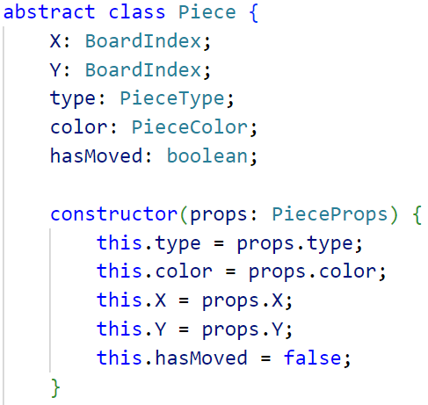
Handle the game logic - the parent piece class
getter and setter are defined in here
checking if the current move is still
in bounds -> index ∈ [0,7]
Calculation of diagonal- & orthogonal moves
since rook, bishop and queen share similar patterns

Slide 4
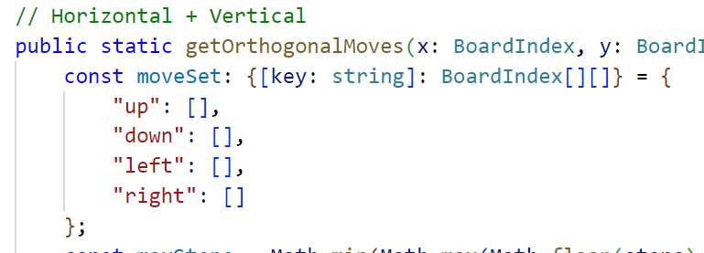
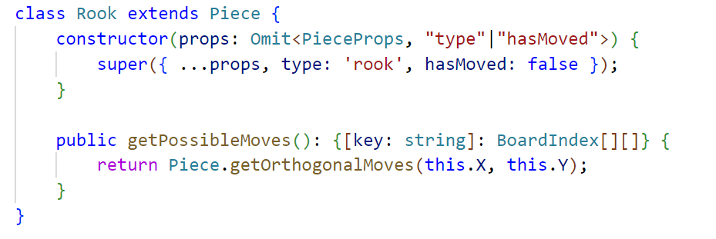
Handle the game logic - the child piece classes
Calculation of all moves:
Take care about Pawns, Kings & Knights
Moveset to be calculated in class
Appending to a dictionary
key is direction we currently moving

Slide 5
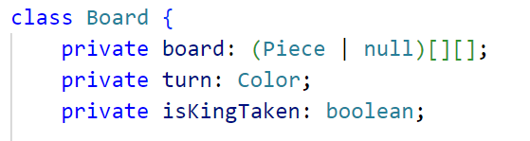
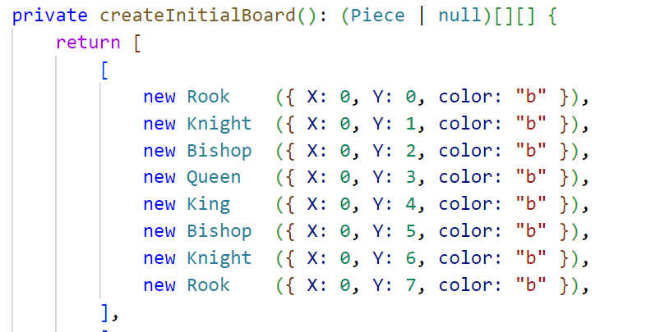
Handle the game logic - the board
Core of the game logic
Move piece method
Calculation of legal moves
By checking if a piece is inside the
trace of the total moveset
reset board method which could be used to surrender
is King taken method to validate the game has ended

Slide 6
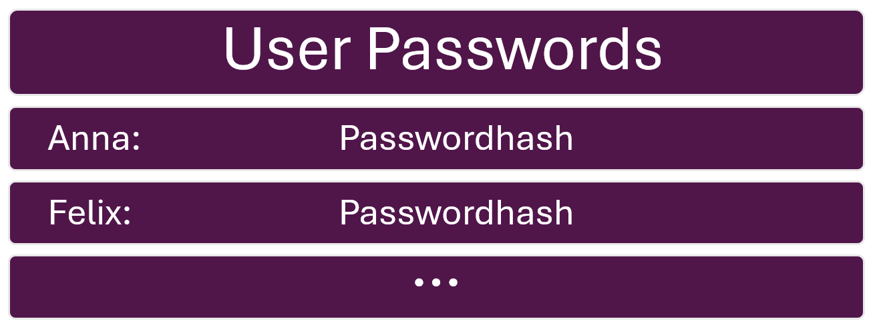
Database - Prisma + sqlite

Slide 7
Authentication - JWT
Login:
Compare password to hash
Create JWT with user information
Authentication:
Include JWT in request header
Authentication Middleware
Verifies the token
Supplements request with user information

Slide 8
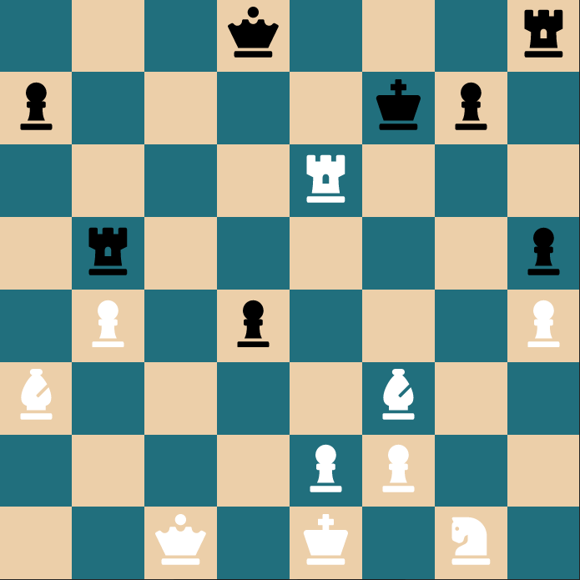
Case Study:
Moving a Rook,
and how the frontend interacts with the backend.

Slide 9
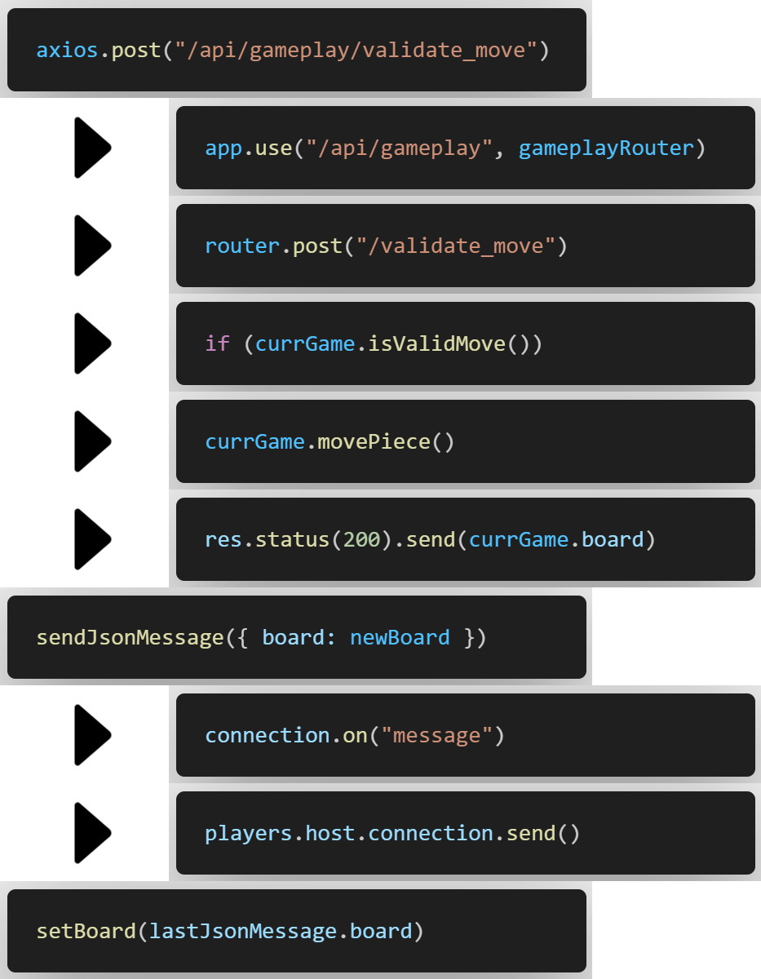
Data Flow
Stage 1: HTTP
Stage 2: WebSockets

Slide 10
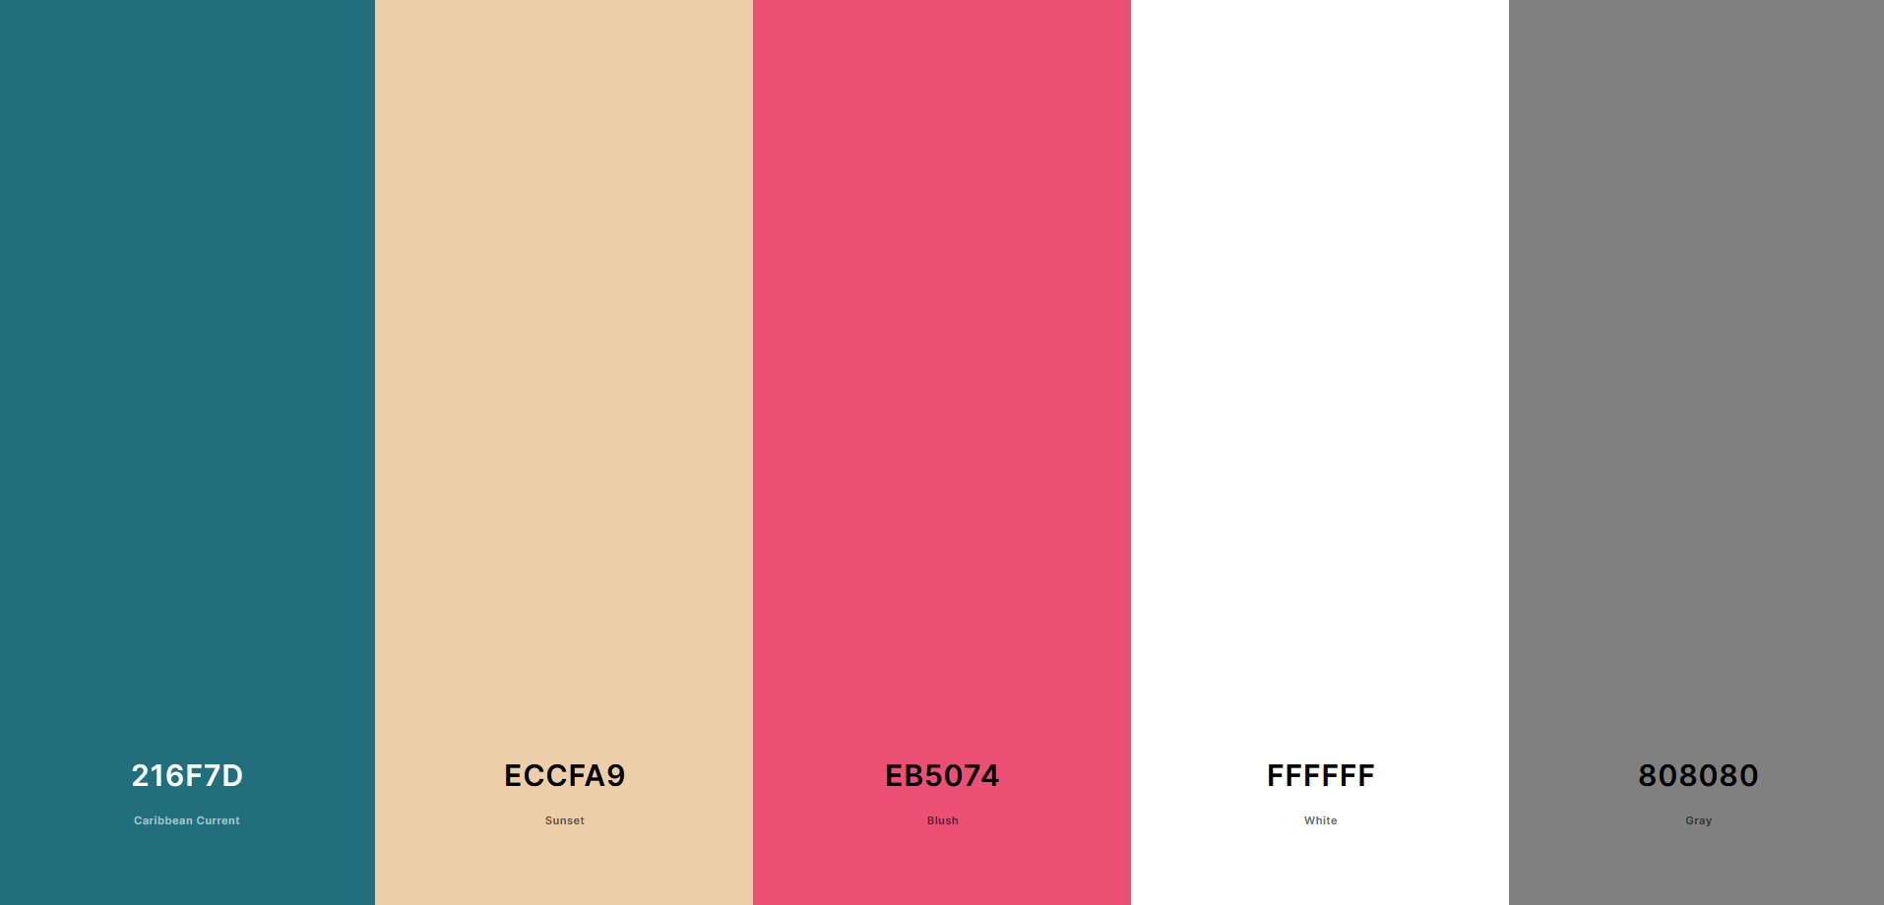
UX/UI - Color Scheme

Slide 11
UX/UI
Animations with Lottie Files

Slide 12
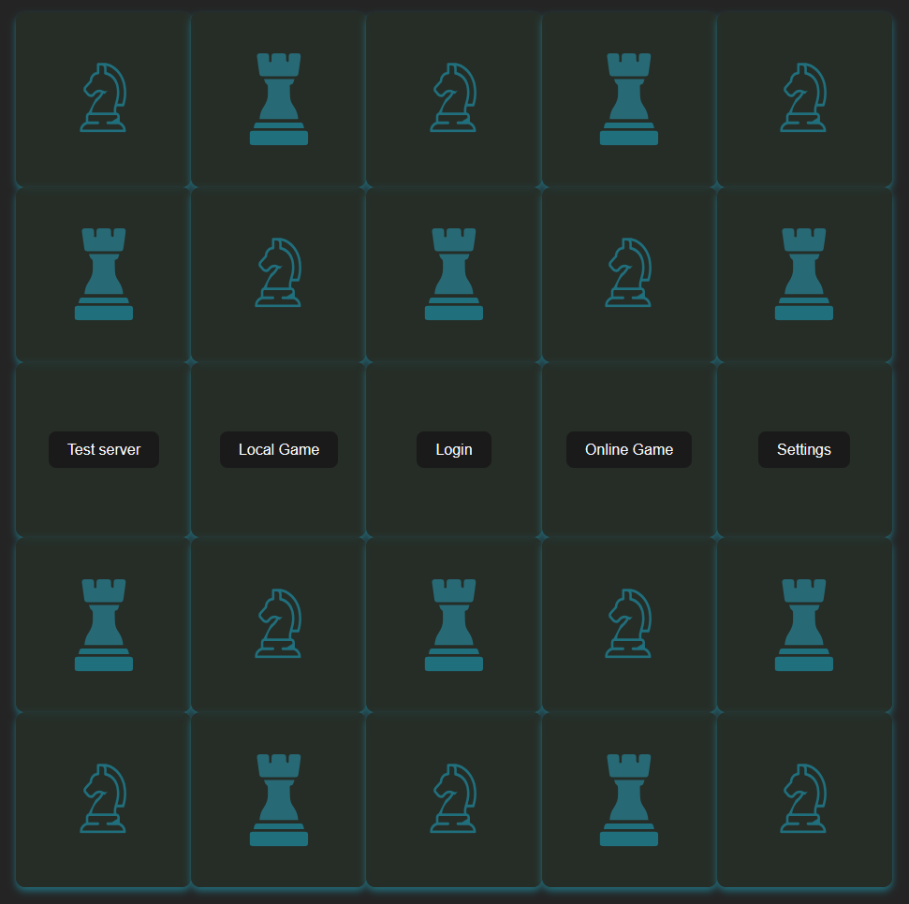
UX/UI
Home Page – with animations

Slide 13
DEMO

